Slide 1

Transitioning Chada Tech to Agile
Strategic Recommendations from the SNHU Travel Pilot
Presented by: Athena Trunkhill
Notes:
Good morning. I’m here today to share the outcomes of the SNHU Travel pilot project. We utilized a Scrum-Agile framework to build this application, and I will be using our real-world experiences to demonstrate why transitioning our Chada Tech development teams away from Waterfall will secure our competitive advantage.

Slide 2

Executive Summary
Accelerated Delivery: Faster speed-to-market.
Risk Mitigation: Continuous testing prevents end-stage failures.
Client Alignment: Adapts to changing market demands instantly.
Notes:
Shifting to Agile solves our biggest developmental bottlenecks. It accelerates our time-to-market, mitigates the risk of massive late-stage bugs, and ensures our final product actually match what the client needs today and not what they asked for six months ago.

Slide 3
The Traditional SDLC:
The Waterfall Model
Requirements
Design
Linear Progression:
  Requirements -> Design -> Implementation -> Testing -> Deployment
  Rigid structure: Phases must be fully completed before moving on.
  High risk of late-stage failure.
Implementation
Testing
Deployment
Notes:
To understand the Agile advantage, we must look at our current standard. Waterfall. It is a linear Software Development Life Cycle. We gather all requirements, design the whole system, code it, and then test it. The problem? If the market changes or testing reveals a fatal flaw at month six, we have to start all over. It's rigid and high-risk.

Slide 4
The Modern SDLC: The Agile Approach
Plan
Review
Design
AGILE
Iterative Cycles:
  Plan -> Design -> Develop -> Test -> Deploy -> Review
  Executed in 2-to-4-week 'Sprints.'
  Delivers working software increments continuously.
Deploy
Develop
Test
(Atlassian, 2024)
Notes:
Agile condenses the SDLC phases into short, repeating cycles called Sprints. Instead of building the whole application at once, we plan, design, develop, test, and deploy a single feature, like a login screen, all in jnust two weeks. This means we are constantly delivering working software and integrating feedback immediately.

Slide 5
The Engine of Agile: Scrum Team Roles
Product Owner: Maximizes business value; manages the Product Backlog.
Development Team: Cross-functional group executing technical work.
Scrum Master: Facilitates the process; removes team roadblocks.
Product Owner
Scrum Team
Development Team
Scrum Master
Notes:
Agile replaces top-down management with three collaborative roles. The Product Owner ensures we are building the right thing for the business. The Scrum Master clears obstacles. The Development Team, which includes coders and testers, executes the work. During the SNHU project, experiencing these roles firsthand proved how this structure creates immense accountability.

Slide 6

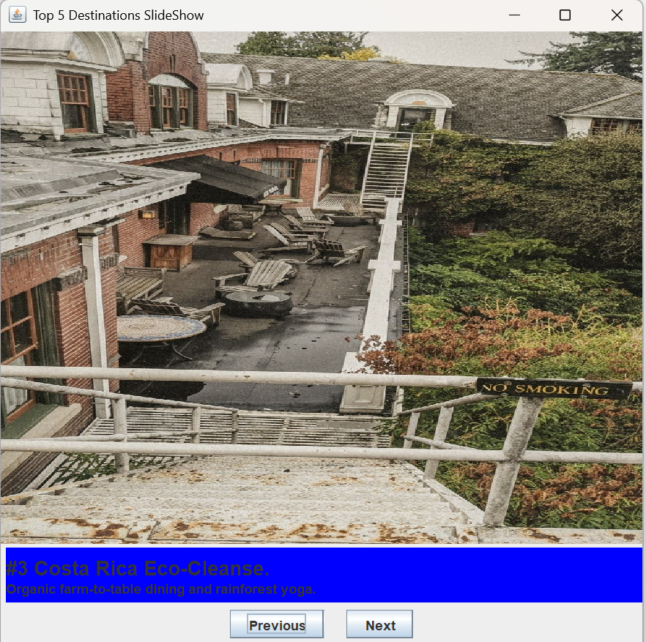
Case Study:
Wellness Changes
The Pivot: Sudden client request for 'Detox/Wellness' features.
Waterfall Impact: Halted production, formal change requests, delayed release.
Agile Solution: Backlog reprioritized; code adapted seamlessly in the next sprint.
(Drummond, 2021)
Notes:
Here is the proof of concept. Mid-project, SNHU Travel requested a massive pivot to 'Wellness' travel. In our traditional Waterfall model, this interruption would have halted production and required a complete rewrite of our requirements documentation. Using Agile, we simply updated our User Stories. The developer refactored the code in the very next sprint, saving weeks of wasted effort and budget.

Slide 7
Strategic Decision Matrix
Choose Agile When:
High market volatility.
Rapid delivery needed.
Continuous client feedback available.
Choose Waterfall When:
Strict regulatory compliance.
Fixed hardware constraints.
Immutable budgets and fixed scope.
Notes:
While I advocate for Agile, it is a strategic choice. Waterfall remains useful for projects with strict government regulations or fixed physical hardware. However, for dynamic custom software where client needs evolve rapidly Agile is definitively the superior framework.

Slide 8

Final Recommendation for Chada Tech
Recommendation: Company-wide transition to Scrum-Agile.
Outcomes expected:
Higher adaptability to client changes.
Reduced risk of delivering outdated products.
Enhanced communication via Daily Scrums
(ADAPT Methodology, 2024).
Notes:
Based on the SNHU Travel pilot, my recommendation is that Chada Tech fully transitions to a Scrum-Agile approach. Utilizing built-in communication events like the Daily Scrum will allow us to respond to market shifts instantly and foster a collaborative environment. This is how we build a more cohesive culture and better products.

Slide 9
References
ADAPT Methodology. (2024, January 13). Effective Daily Scrum meeting: Unveiling the pillar of Agile success. https://adaptmethodology.com/blog/effective-daily-scrum-meeting/
Atlassian. (2024). Agile project management: The complete guide for agile projects. https://www.atlassian.com/agile/project-management
Drummond, B. (2021). Agile Product Management: User Stories. Independent.
Verheyen, G. (2021). Scrum - A Pocket Guide: A Smart Travel Companion (3rd ed.). Van Haren Publishing.

